Slide 1
Customer Churn Prediction
NAME:VIOLA KIMITEI
Phase 3 Project

Slide 2
Project Overview
This project focuses on predicting customer churn,whether a customer is likely to stop doing business with SyriaTel Telecommunication company using historical usage data and service plan information. By leveraging machine learning techniques such as Decision Trees and Logistic Regression, we aim to build a predictive model that can identify high-risk customers before they leave. This churn model can serve as a valuable tool for our company to take proactive retention measures, optimize customer relationship strategies, and reduce revenue loss due to customer attrition.

Slide 3
Business and Data Understanding
Our company SyriaTel has noticed that Customer churn is a critical problem and acquiring a new customer is significantly more expensive than retaining an existing one. The business goal is to:
1.Predict customer churn to help the company identify customers at risk of leaving.
2.Understand key drivers of churn such as international plans, customer service calls, and usage patterns.
3.Build predictive models for churn ie. Decision Tree and Logistic Regression to Optimize retention strategies.
Churn prediction models based on our data can help reduce customer attrition and increase customer lifetime value both which are helpful in long term profitability.

Slide 4
Data source
we will download our data from https://www.kaggle.com/becksddf/churn-in-telecoms-dataset

Slide 5
Comparing Decision Tree with Logistic Regression
Decision Tree
Logistic Regression
FINDINGS: Accuracy: 91%, Precision (churn): 65%, Recall (churn): 70%
High performance and interpretability; good at identifying churners.
FINDINGS: Accuracy: 86%, Precision (churn): 49%, Recall (churn): 18%
Lower recall; poor at catching actual churners due to class imbalance.
We conclude that:
A decision tree model offers an effective and interpretable solution compared to logistic regression, enabling targeted retention strategies. This model can be deployed as part of a customer relationship management system to help prioritize customers at risk and improve overall business performance.

Slide 6
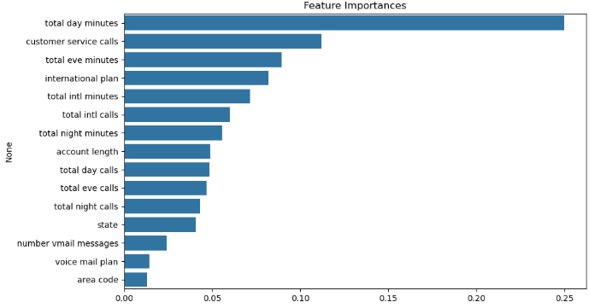
Modelling and Evaluation
Comparison of all feature that are likely to contribute to churn

Slide 7
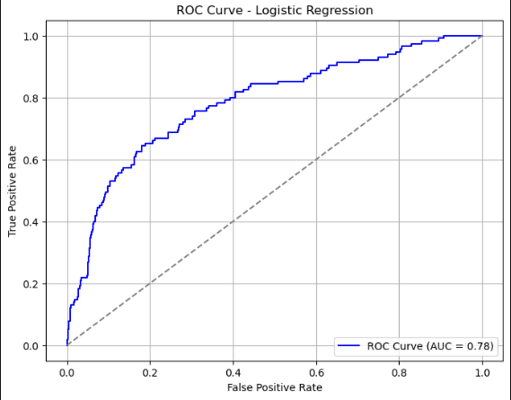
ROC Curve and Compute AUC
The model shows a strong AUC score, demonstrating good ability to distinguish churners from non-churners.

Slide 8
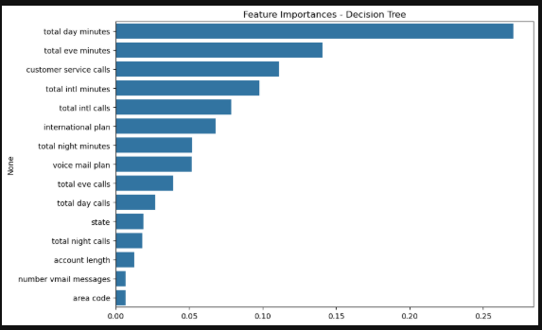
Decision Tree Model
Decision Tree Model

Slide 9
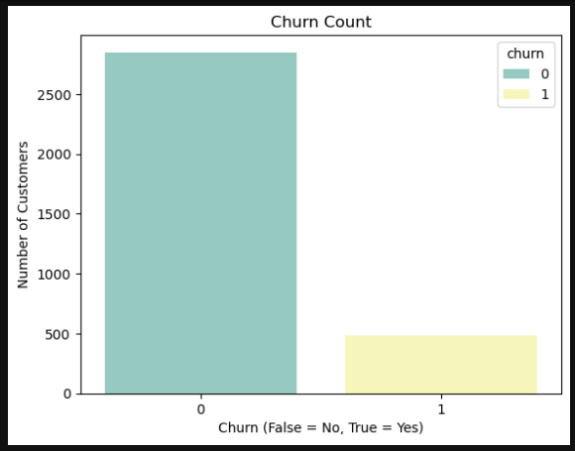
Churn Rate Distribution
Based on our graph there were more churners than non churners

Slide 10
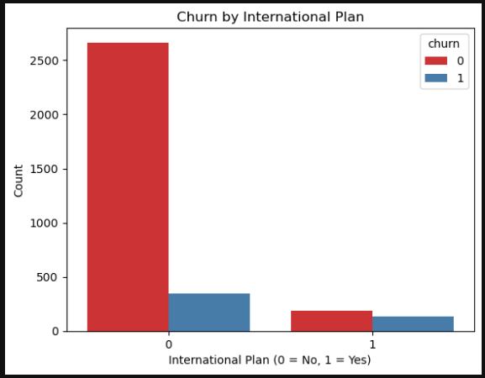
Impact of International Plan
Our model shows that the customers with international plan were more likely to churn.

Slide 11
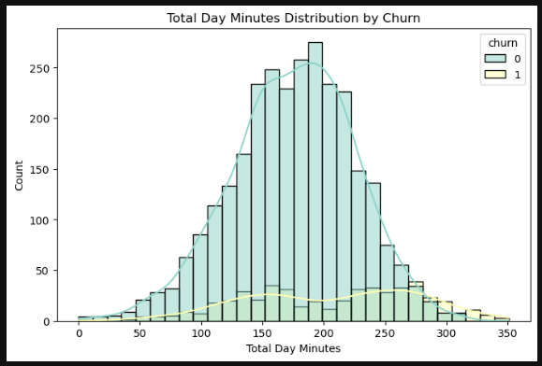
Daytime Usage
High daytime usage may indicate that premium users are more prone to switching for better deals.

Slide 12
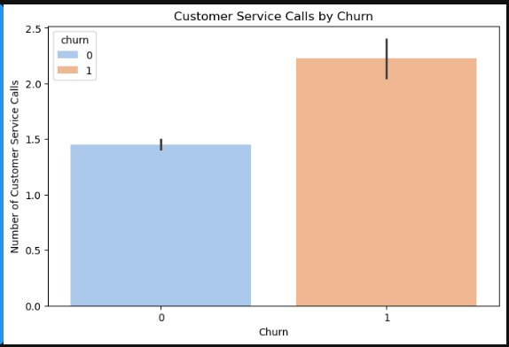
Impact of Customer Service Calls
Poor customer service indicates high number of churns.

Slide 13
Recommendation and Conclusion
Recommendations
The company should adopt Decision Tree Model because its high recall makes it a better fit for prediction.
Customers with international plans are more likely to churn therefore the company should focus more on them to provide better deals to incease retension.
The company should revamp customer service calls to ensure that customers receive top notch customer experience.
Introduce offers and better deals for daytime usage as this has proven low churns.
Improve Logistic Model by use of SMOTE or class weighting to balance churn vs. non-churn classes.
Conclusion
Customers on an international plan are more likely to churn.
Higher customer service call volume is linked with churn possibly indicating dissatisfaction.
High daytime usage/charges may indicate premium users more prone to switching for better deals.
A decision tree model offers an effective and interpretable solution compared to logistic regression, enabling targeted retention strategies. This model can be deployed as part of a customer relationship management system to help prioritize customers at risk and improve overall business performance.

